Slide 1



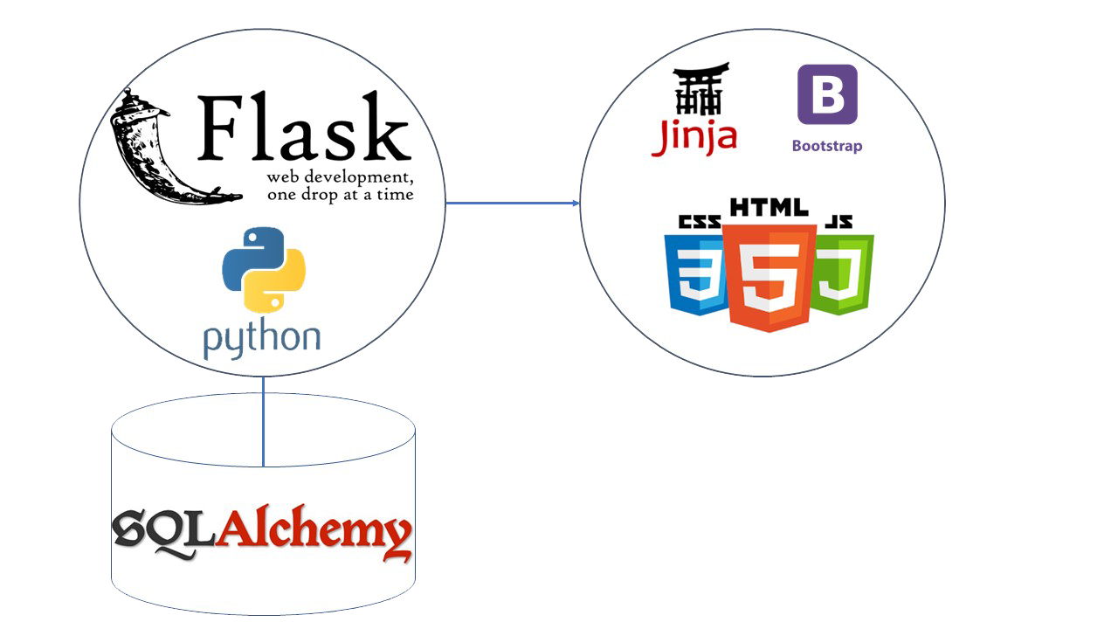
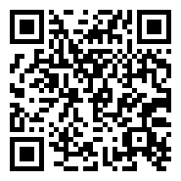
My Health Aid
Iska Yaakov, Noa Shalit-Snir, Olga Reznyk Yulia Gendler , Yossi Zaguri
Project goal
A system that aids in making the proper & accurate personalized health-oriented decision.
Introduction
Delivering medical content in an orderly, professional and efficient manner from the medical And paramedical staff to the Patients.
Easy to operate and accessible for use on both the patient and medical staff side.
Health teams can maintain it independently without the need for IT support by using built-in templates to produce additional health content accordingly to their needs.
Tracking the system, what medical information the users were looking for, where more medical information is needed, etc..
Alternatives and Considerations
For the initial phase, the system will be internal in the university for research needs.
There will be respondents who will fill out the questionnaires for research purposes, understanding the process and improving the aids.
The system will be in a laboratory in the Faculty of Health Professions at the University and will be managed by Dr. Julia Gendler, a lecturer and researcher in the faculty, who will be responsible for developing decision aids, recruiting and supervising a team of researchers and research assistants.
Selected Approach
Features of the product
Several templates for the convenience of the researcher / research assistant to build questionnaire according to the research needs
Analyzing features for easier understanding of patients needs.
Keeping research files and user data secure.
Visit Us

